Slide 1
World Economy Heading for Another Period of Weakness
27th October, 2015 at International Institute of Social Studies
Dr. Howard Nicholas
Senior Lecturer in Economics,
Erasmus University of Rotterdam,
The Netherlands

Slide 2
Understanding the Current State of Economy
Shift in global economic power from advanced to developing countries, particularly East and South Asian.
Business cycles.

Slide 3
GLOBAL SHIFT IN POWER

Slide 4
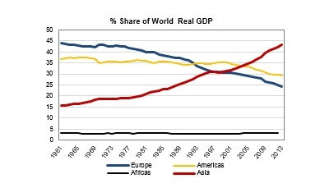
Regional Shift in World GDP Share,
1961-2013
Notes:
Source: http://www.worldeconomics.com/papers/Global%20Growth%20Monitor_7c66ffca-ff86-4e4c-979d-7c5d7a22ef21.paper

Slide 5
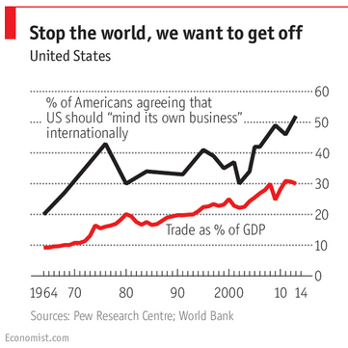
US becoming increasingly dependent on trade

Slide 6
Shift in Shares of World GDP for China, India and Sri Lanka, 1980-2014
 | 1980 | 2014
China | 2.3% | 16.3%
India | 3.0% | 6.8%
Sri Lanka | 0.12% | 0.20%

Slide 7
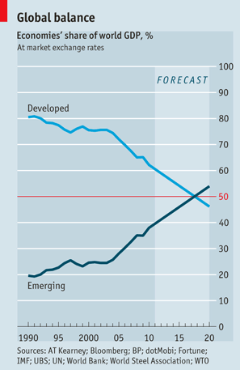

Slide 8
CYCLES IN THE WORLD ECONOMY

Slide 9
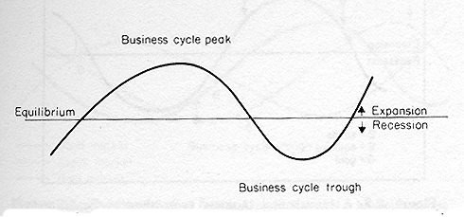
A typical cycle

Slide 10
Types of cycles
Cycle | Duration | Source
K-Wave | 50-60 yrs | Major innovations
Juglar | 7-11 yrs | Fixed capital investments

Slide 11
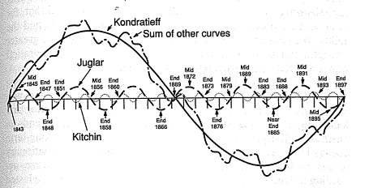
Combining waves
Notes:
Source: Schumpeter, J (1939).

Slide 12
Long cycle dating
Trough | Peak | Trough | Duration | Hegemonic Power | Technology
1790 | 1814 | 1848 | 58 | Britain | Canals
1848 | 1872 | 1893 | 45 | Britain | Railways, Steam (steam engine)
1893 | 1917 | 1940 | 47 | Britain | Steel, Combustion engine, Electricity, Chemicals, Telephone
1940 | 1975 | 2009 | 60 | United States | Electronics, Plastics, Aerospace, Nuclear energy
2009 | 2030 | 2050 | 50 | China/E.Asia | Computers, Biotechnology, Robotics
Notes:
Source: Goldstein (1988) modified.

Slide 13
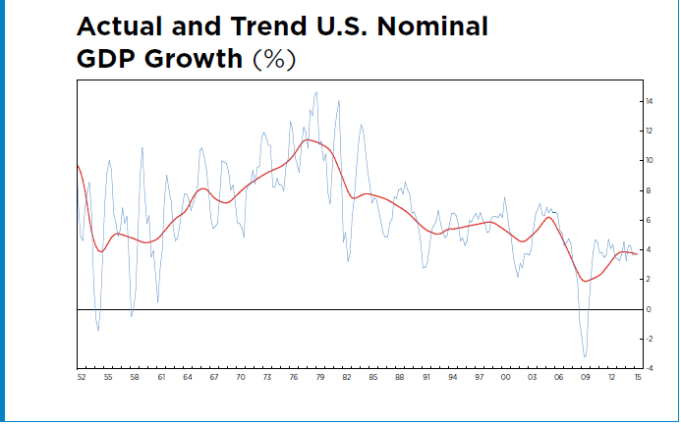
Falling US growth in the context of the long cycle
Notes:
Source: ECRI

Slide 14
Juglar dating – cycle bottoms
1958
1970
1975 (oil shock)
1980
1991
2001
2009
2016 (my estimate)
Notes:
http://www.imf.org/External/Pubs/FT/GFSR/2011/02/pdf/ch2.pdf, p.7

Slide 15
Economic growth and inflation slowing between recent short cycles
 | 2003-7 | 2010-14
Growth
Advanced economies | 3.3 | 2.5
BRICs | 8.3 | 6.2
Inflation
Advanced economies | 2.3 | 1.5
BRICs | 5.3 | 4.9
Notes:
Source: World Bank. Calculated by Author

Slide 16
FUTURE PROSPECTS

Slide 17
Short-run (next couple of years)
US and Europe will follow E. Asian countries into recession in 2016, but not necessarily a major fall in stock markets.
More quantitative easing in US, Europe, Japan and China.(1)
Fiscal stimulus in China and advanced countries.
Notes:
1. Governments will reduce money market interest rates, even pushing them into negative territory and increase money printing – buying private sector debt and even equities.

Slide 18
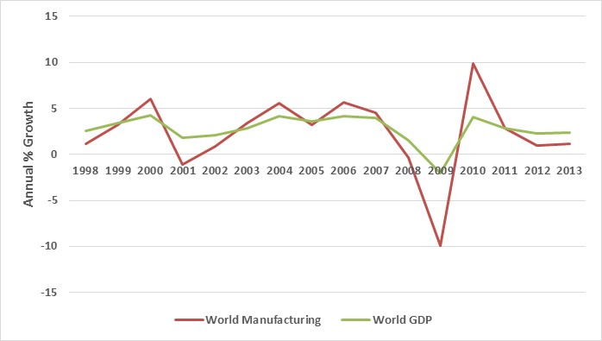
Manufacturing driving world GDP
Notes:
Source: World Bank. Chart by Author

Slide 19
Shares of world manufacturing;
US, EU and E. Asia, 1997-2014
Notes:
Source: World Bank. Chart by Author

Slide 20
Growth of Chinese industrial production and primary commodity prices, 2008-2015
Notes:
Source: World Bank. Chart by author.

Slide 21
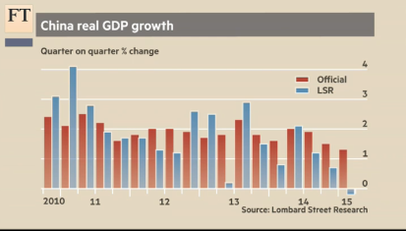
China may already be in recession

Slide 22
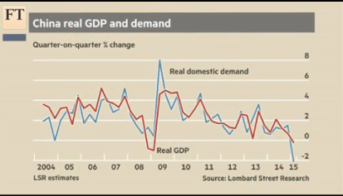
Don’t count on Chinese consumers

Slide 23
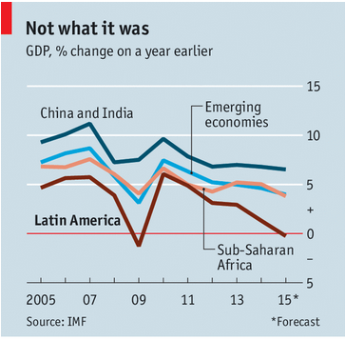
Emerging markets falling fast

Slide 24
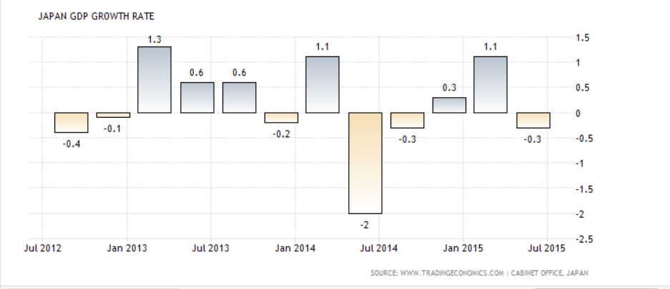
Japan weakening

Slide 25
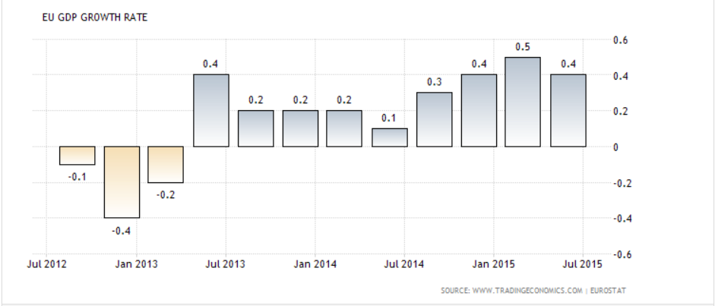
Europe recovering?

Slide 26
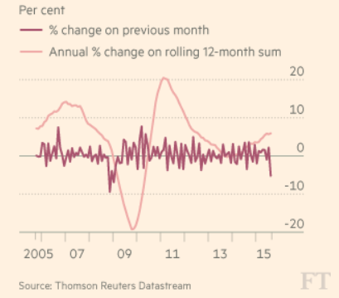
The German export engine is losing steam

Slide 27
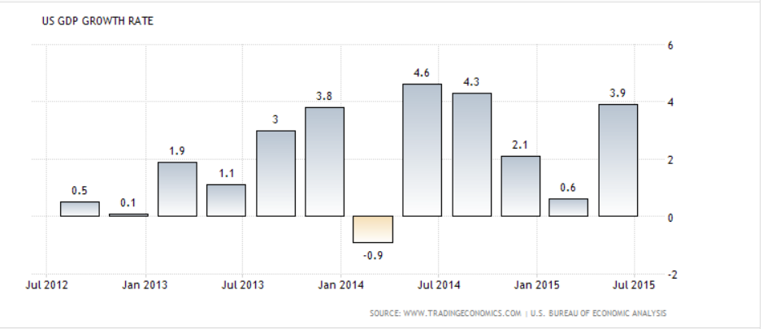
US remaining strong

Slide 28
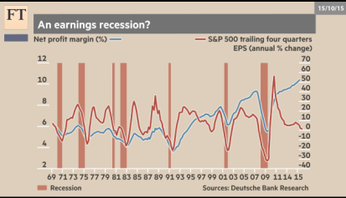
US earning growth falling

Slide 29
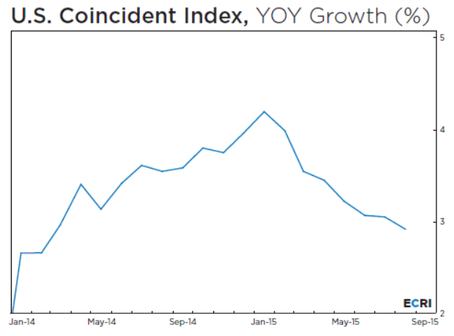

Slide 30
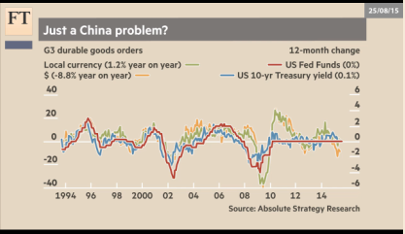
G3 durable goods orders suggesting weakness

Slide 31
Long-run (upswing of the long business cycle)
Continuing shift of wealth and power to the developing countries.
Many more developing countries will shift towards manufacturing production.
  The successful ones will attract manufacturing production seeking to relocate from China and other high-cost East Asian producers.
Some recovery in primary commodity prices.
Misguided monetary stimulus policies of the advanced countries could considerably delay the up-turn of the long business cycle.

Slide 32
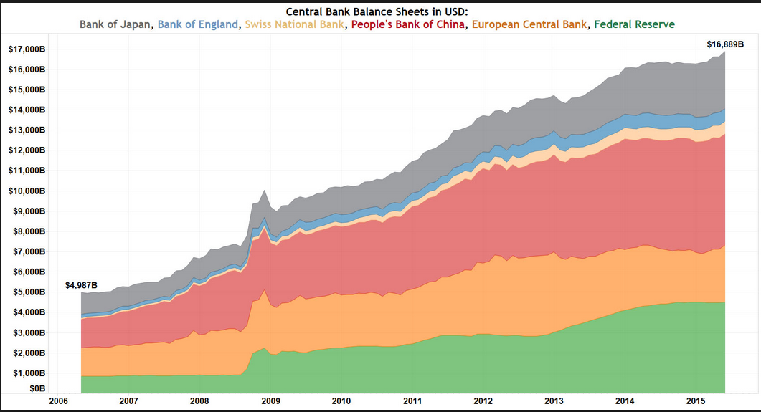
Printing by central banks

Slide 33
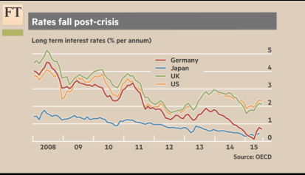
Falling long-term (10 year) interest rates, Germany, Japan, UK and US

Slide 34
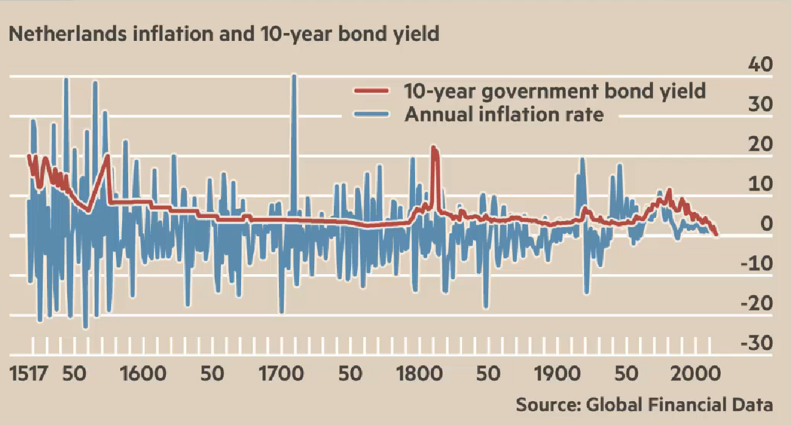
Historically low long-term interest rates

Slide 35
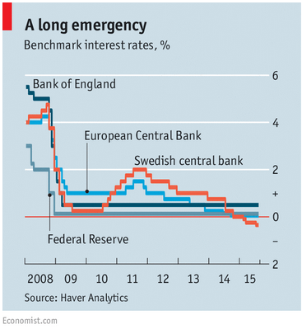
…and short term interest rates

Slide 36
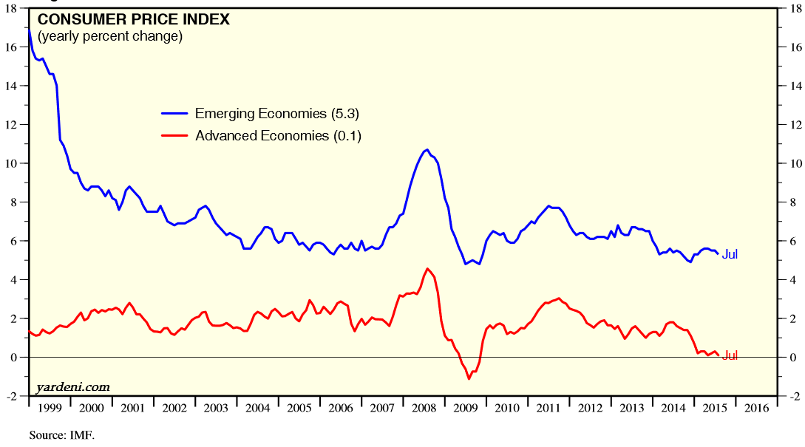
What did QE achieve?

Slide 37
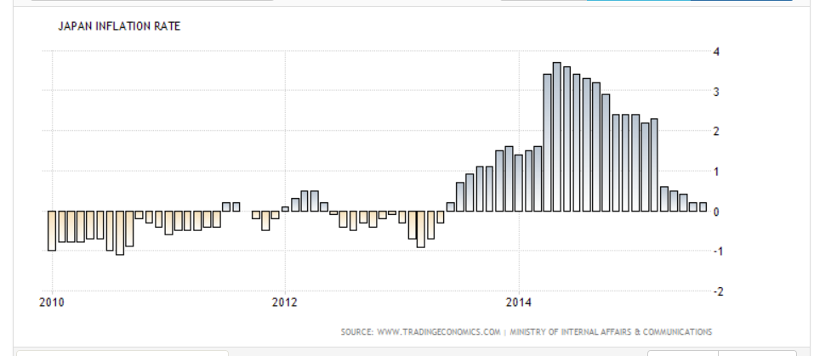
QE and inflation in Japan?

Slide 38
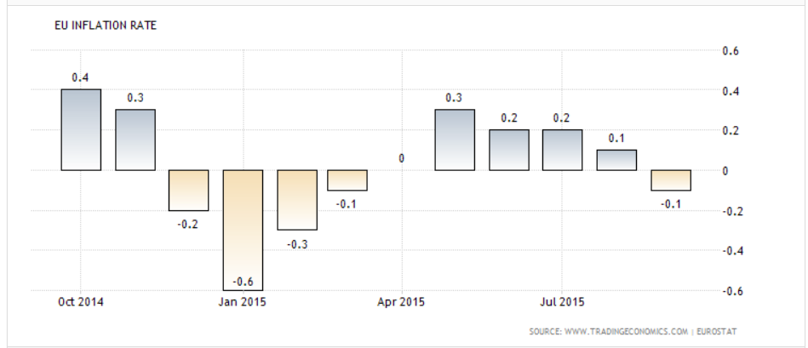
QE and inflation in Europe?

Slide 39
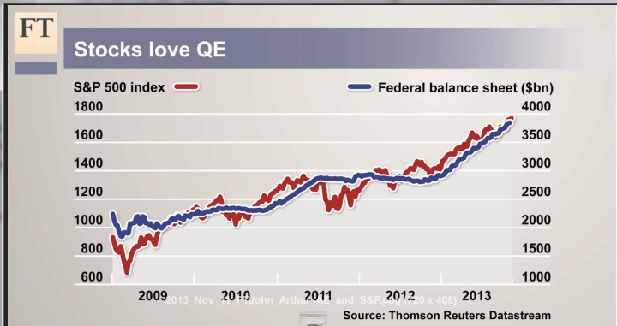
…Asset price inflation

Slide 40
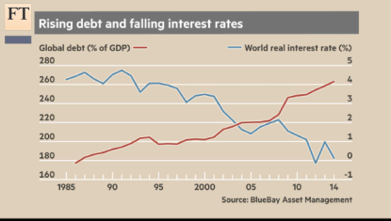
Falling global interest rates encouraging surge in global debt

Slide 41
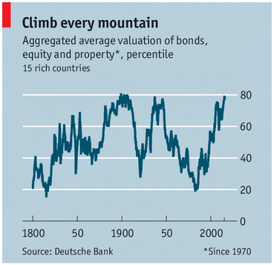
A mega asset price bubble?

